Slide 1

VPC ()
Public Subnet (202.165.17.46)
Google
ECS - Bastion
NAT
Met Malaysia
Private Subnet/App (202.165.29.35)
OpenMetro
APIG
ECS - App
EVS (500 + 500)
User
OpenData
PETRA
Private Subnet/Data ()
FunctionGraph
OBS
DLI
CSS
DWS
API

Slide 2
Public Subnet:10.0.1.0/24
NAT
Public Access
ECS-Bastion
API Gateway
Private Access through ECS-Bastion
Private Subnet:10.0.2.0/24(App)
Private Subnet:10.0.3.0/24(Data)
ECS-App
DWS
CSS
FunctionGraph
EVS
(500+500(
API
OBS

Slide 3
No. | Components | Actual Resource / Name | Current Status / Purpose
1 | Virtual Private Cloud / Network | NAHRIM-VPC | Set up a VPC and attached one public subnet and 2 private subnet where CSS, ECS, and other services live. Ensures all core services talk over private IPs.
2 | Nat Gateway | NAHRIM-NAT | Attached in the Public subnet(Bastion Host) for the private nahrim-app-ecs to access internet to install pip/environment.
3 | Elastic Cloud Server (ECS) | Nahrim-bastion | Attached to the public subnet(nahrim-bastion) to access privately to nahrim-app-ecs. Created as bastion / jump host in same VPC. Has public EIP; used to reach internal services (CSS, etc.) using private IP.– Verified CSS access using curl from here.
4 | Elastic Cloud Server (ECS) | nahrim-app-ecs | For application workloads, ETL,temp files, logs, developer deployments.
8 | Elastic Volume Service – General Purpose SSD 500 GB (x2) | EVS-Volume1 and EVS-Volume2 | Created 2 EVS data disks in AZ1: Type: High I/O (per your choice). Size: 500 GB each. Attached both disks to nahrim-app-ecs. Verified from VM using lsblk - saw vdb and vdc (each 500G). All processing, ETL, indexing tasks, dev workloads run on the app ECS. Developers store logs / data / pipelines here. Processing disk space must be large

Slide 4
No. | Components | Actual Resource / Name | Current Status / Purpose
6 | EVS Disks – Partitioning, formatting, mounting | On nahrim-app-ecs: /dev/vdb1 - /data1, /dev/vdc1 - /data2 | Partitioning (fdisk): For /dev/vdb and /dev/vdc: – sudo fdisk /dev/vdb - n (new) - p (primary) - 1 - accept default first/last sectors - w (write). Same for /dev/vdc. Result: vdb1, vdc1 (500G each). Formatting: sudo mkfs.ext4 /dev/vdb1 – sudo mkfs.ext4 /dev/vdc1 Mount points: sudo mkdir -p /data1 /data2 – sudo mount /dev/vdb1 /data1 – sudo mount /dev/vdc1 /data2 – Verified with df -h - both show - 492G free.
7 | Cloud Search Service (CSS) – “Cloud Search Service|8vCPUs|32GB” and “Cloud Search Storage|Ultra-high IO 700GB” | CSS cluster nahrim-css with 3 nodes: 10.0.3.180, 10.0.3.108, 10.0.3.220, port 9200 | Confirmed cluster is up and healthy from bastion: curl http://10.0.3.180:9200/_cluster/health - status green. Created a test index nahrim_test and ingested a doc (“css working”), then verified search works (_search?pretty). CSS is fully functioning inside VPC; internal HTTP endpoint only.
8 | API Gateway – Basic Instance (“Apig basic version instance”) | API Gateway instance apig-nahrim | Confirmed instance running (used it to host APIs). API Gateway is the public entry point for APIs calling internal services.

Slide 5
No. | Components | Actual Resource / Name | Current Status / Purpose
9 | API Gateway – Public outbound access | API Group: nahrim-servicesAPI: css_health | Frontend config for css_health:Group: nahrim-services. Method: GET. Path: /css-health (exact match). Visibility: Public, Auth mode: None (for now, internal/testing). Backend config: Backend type: HTTP. Method: GET. Path: /_cluster/health. When debugging now, calling GET https://<apig-domain>/css-health returns live CSS health JSON. And also from bastion host: curl -i "http://2489b3355d29412b8bbe6ad6a9ec493e.apgw-alphaedge.com.my/css-health"
10 | API Gateway – Load balancing (internal) | Load Balance Channel lb-css-health | Created a load balance channel for CSS: Type: Server (IP address). Port: 9200. Members: 10.0.3.220, 10.0.3.108, 10.0.3.180 (all CSS nodes). Health check: TCP, port 0 - uses main port (9200); interval 10s; thresholds tuned to defaults. Confirmed all three backends show Healthy in console. Provides HA access: API Gateway hits lb-css-health, which round-robins across 3 CSS nodes.

Slide 6
No. | Components | Actual Resource / Name | Current Status / Purpose
11 | FunctionGraph | nahrim-etl (Python 3.9) | Lambda-style serverless function. Connectivity test added — confirms FunctionGraph can reach DWS via private IP 10.0.3.185:8000. Execution success verified.
12 | GaussDB(DWS) – Data Warehouse Cluster | nahrim-dws (3 nodes) | Status: Available. Version 9.1.0.218. Private IP: 10.0.3.185. Default DB: gaussdb. Used for analytics/warehouse. *remark: cannot obtain obs datasource connection because it requires the DWS agency which is not in the agency selection. Need to consult with Huawei Cloud team
13 | OBS – Object Storage Buckets | nahrim-raw, nahrim-staging, nahrim-processed, nahrim-search-docs, nahrim-logs | Buckets successfully created following ETL architecture: raw – staging - processed -logs. search-docs for CSS - This bucket is used to store uploaded documents (PDFs, DOCX, images, etc.) which will later be processed and indexed into the CSS cluster for search.
14 | Data Governance Service Center (DGC) |  | *remark: need assistance to set up this component

Slide 7
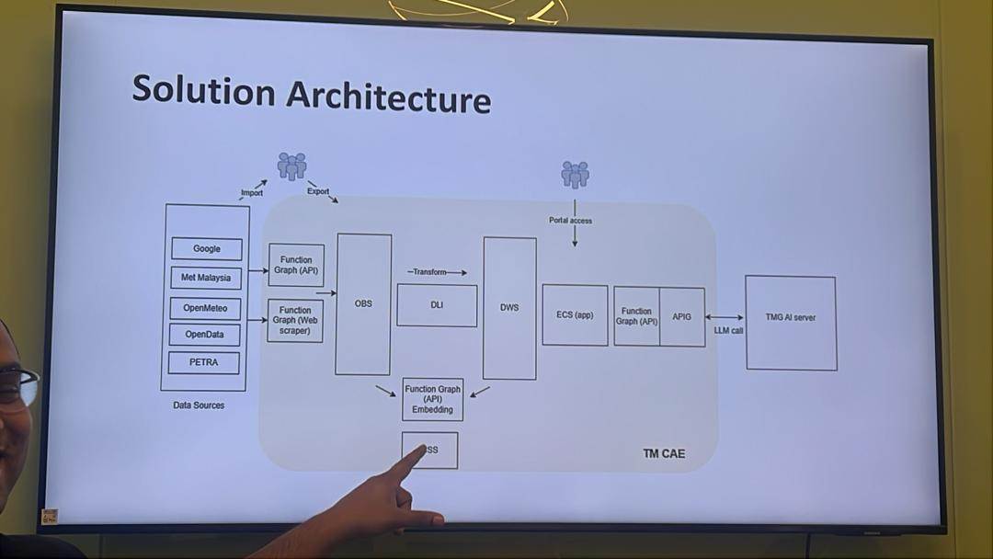

Slide 8
CCE
ORM
App
Authorization
Authentication
Drizzle ORM
NextJS
Better Auth
IAM
DWS
User
CSS
Azure OpenAI
Self-Hosted
LLM
LLM
GPU

